Slide 1
Conceptual Database Design

Slide 2
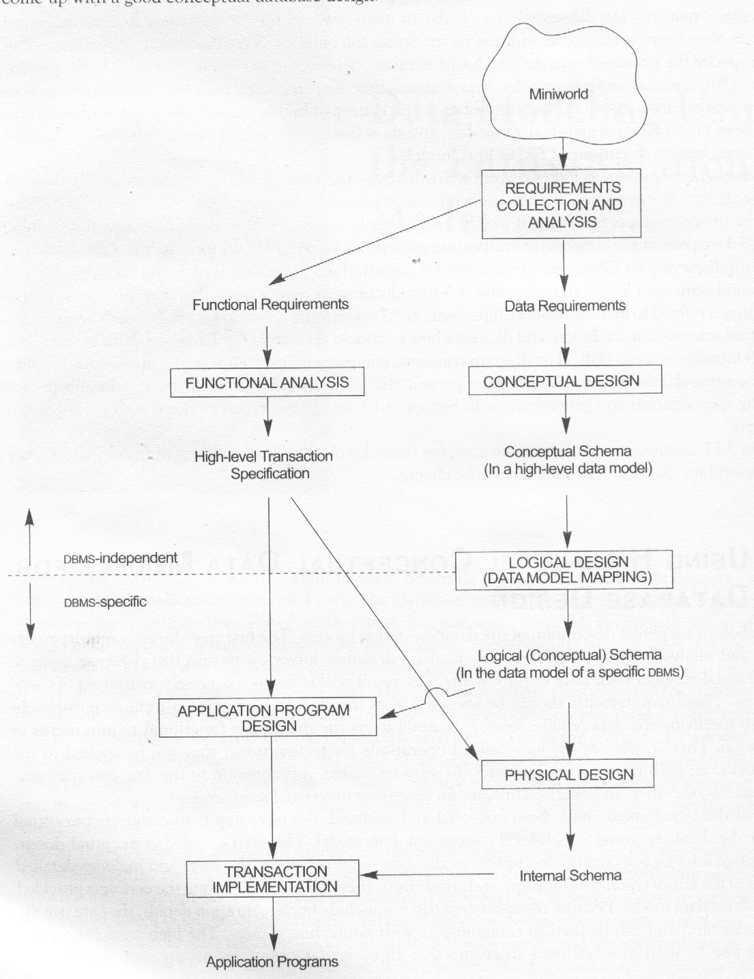
Using High-level Conceptual Data Model For Database Design
Figure shows a simplified description of the database design.
At first the database designers interview prospective database users to understand and document their data requirements. The output of this process is a concisely written set of users requirements.
In parallel with specifying the data, functional requirements of users are also identified. It includes both retrievals and updates.
Once all the requirements have been collected and analyzed, the next step is to create a conceptual schema for the database using high level conceptual data model. The conceptual schema is a concise description of the data requirements of the users and includes detailed description of the entity types, relationships, and constraints.
The nest step in database design is to implement the conceptual model using a commercial DBMS. Most commercial DBMSs use an implementation data model –such as the relation or the object-relation database model. This is called logical design.

Slide 3
An Example of Database application
Consider a company database which keeps track of a company’s employees, departments, and projects. The following information is obtained from the mini-world after requirements collection and analysis:
The company is organized into departments. Each department has a unique name, unique number, and a particular employee who manages the department. We keep track of the start date when that employee began to managing the department. A department may have several locations.
A department controls a number of projects, each of which has a unique name, a unique number, and a single location.
We store each employee’s name, employee’s number, address, salary, sex, and date of birth. An employee is assigned to one department but may work in on several projects, which is not necessarily controlled by the same department. We keep track the number of hours per week that employee works on each project. We also keep track of the direct supervisor of each employee.
We want to keep track of the departments of each employee for insurance purposes. We keep each dependent’s first name sex, date of birth, and relationship to the employee.

Slide 4
Entity-Relationship Model
ER model describes data as entities, relationships and attributes.
Entity is the building block of ER model

Slide 5
Entity types, Entity sets, and Attributes
Entity: is an object in the real world which is distinguishable from the other objects.
Entity Type: a collection of entities that have the same attributes.
Entity set: The collection of all entities of a particular entity type in the database at any point in time.
Attributes: An entity is described by a set of attributes. An attribute has a domain of possible values.
Several types of attributes occur in the ER model.
They are:
Simple attributes: are atomic
Composite attributes: can be divided into smaller subparts, which represent more basic attributes with independent meaning.
Single-valued attributes: Most attributes have a single value for a particular entity; such attributes are called single valued. Example- age.
Multi-valued attributes: In some cases an attribute can have a set of values for the same entity- for example, a Colors attribute for a car.
Derived attributes:

Slide 6
Keys
A key is a minimal set of attributes that uniquely identify an entity in an entity set.
Super key: Any set of attributes which can uniquely identify an entity in an entity set is called super key.
Candidate key: The minimal set of attributes which can uniquely identify an entity in an entity, is called candidate key.
Primary key: Candidate key used by database designer is called primary key.

Slide 7
Initial Conceptual Design of the Company Database
According to the requirement description, we can identify four entity types.
DEPARTMENT with attributes- Name, Number, {Locations}, Manager, Manager_Startdate where Location is a multi-valued attribute.
Project with attributes- Name, Number, Location, Controllingdepart.
Employee with attributes- Name, ENO, Sex, Address, Salary, DOB, Department, Supervisor, {WorkOn (Project, Hours)}
Dependent with attributes- ENO, Dependentname, Sex, DOB, Relation

Slide 8
Relationship Types, Sets, and Instances
Whenever an attribute in an entity type refers to another entity type, some relation exists. For example department attribute in Employee entity refers the Department entity type.
Relationship type R: among n entity types E1, E2, ………En defines a set of associations among entities of these entity types. Mathematically, the relationship set R is set of relationship instances r_{i}, where each r_{i} associates n individual entities (e1, e2,………..en) and each entity ej is a member of entity type Ej, 1 <= j <= n.
Employee Work_for Department
e1
e2
e3
e4
r1
d1
r2
d2
r3
d3
r4

Slide 9
Degree of Relationship
The degree of a relationship type is the number of entity type participate in a relationship.
The relationship type of degree two is called binary, and one of degree three is called ternary.

Slide 10
Recursive Relationship
There are some situations where the same entity type participates more than once in a relationship type in different roles. Such relationship types are called recursive relationships.

Slide 11
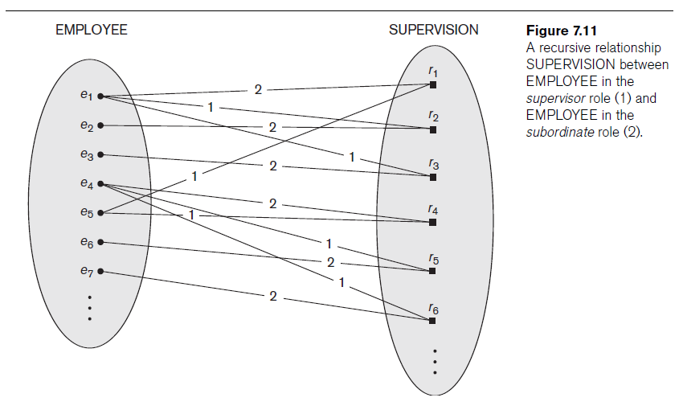

Slide 12
Cardinality ratio for binary relationships
The cardinality ratio for a binary relationship specifies the maximum number relationship instance that an entity can participate in. For example in work_for relation type, Department : Employee is of cardinality ratio 1:N.
Participation constraints: specifies whether existence of an entity depends on its being related to another entity via relationship type. There are two types of participation constraints- total and partial.
If the company policy states that every employee must be work for a department, then employee entity can exist only if it participates in at least one work_for relationship instance. The participation of Employee in Work_for is called total participation.
In ER diagrams, total participation is displayed as a double line connecting the participating entity to the relationship, whereas partial participation is represented by a single line.

Slide 13
Weak Entity Types
Entity types that do not have key attributes of their own are called weak entity types. An entity type that has a primary key is termed a strong entity type.
A weak entity type must be associated with an strong entity type, called identifying or owner entity type.
A weak entity type normally has a partial key, which is the set of attributes that can uniquely identify weak entities that are related to the same owner entity.
The primary key of a weak entity is formed by the primary key of identifying entity type, plus the partial key of that weak entity type.

Slide 14
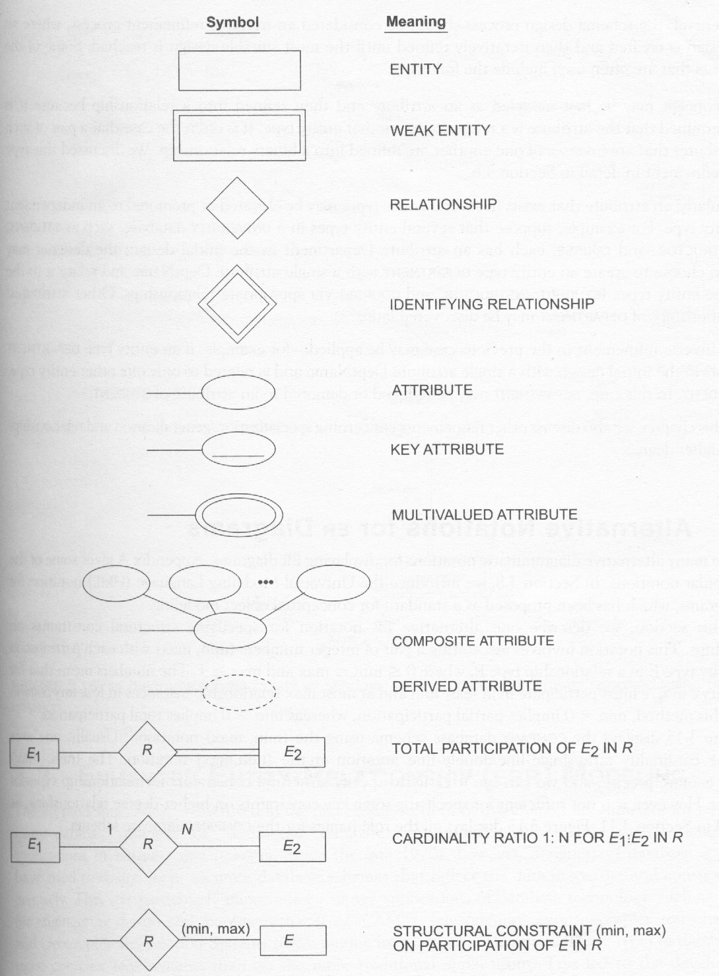
Summary of Notation for ER Diagrams

Slide 15
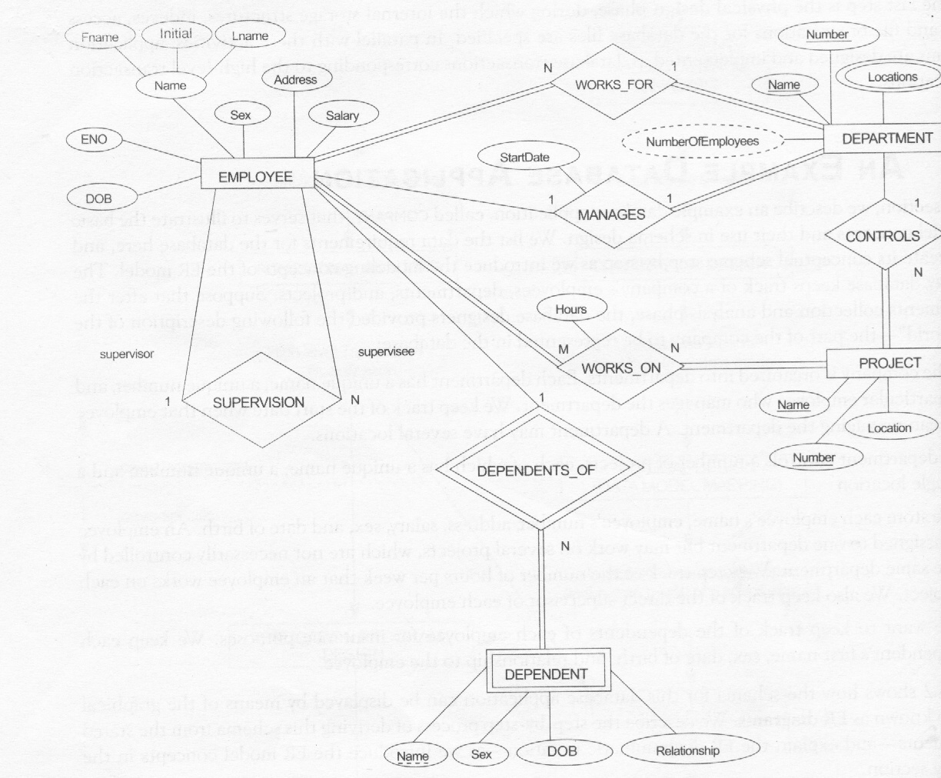
An ER schema diagram for the company database

Slide 16
Enhanced ER Model

Slide 17
Subclass and Inheritance
An entity class B is said to be a subclass of another entity class A, If it shares an “is-a” relationship with A.
For example: car “is-a” vehicle

Slide 18
Subclass and Inheritance
An entity cannot exist in the database merely a member of a subclass. It must also be a member of the superclass.
However, it is not necessary that that every entity in a superclass be a member of some subclass.
Subclasses undergo type inheritance of the superclass. That is, each member of a subclass has the same attributes as the superclass entities and participates in the same relationship types.

Slide 19
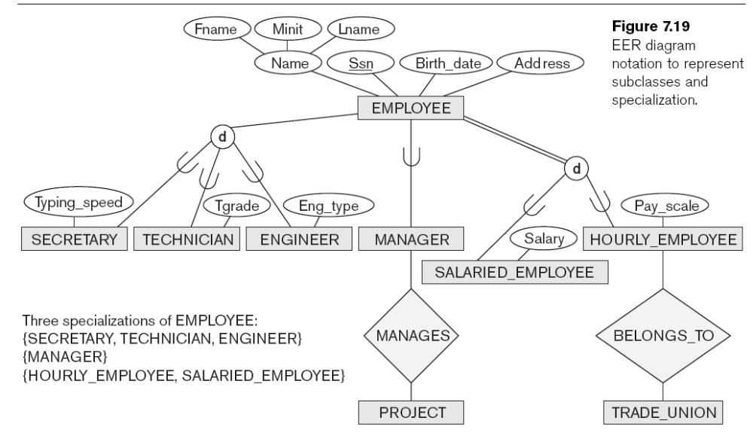

Slide 20
Specialization and Generalization
Specialization is the process of defining a set of subclasses of an entity type; this entity type is called the superclass of the specialization.
We can think of a reverse process of abstraction in which we suppress the differences among several entity types, identify their common features and generalize them into a single super-class. We use the term generalization to refer to the process of defining a generalized entity type from the given entity types.

Slide 21
Specialization
There are two main reasons for including class/subclass relationship and specialization in a data model.
The first is that certain attributes may apply to some but not all entities of the superclass. A subclass is defined in order to group the entities to which these attributes apply.
The second reason for using subclass is that some relationship types may be participated in only by entities that are member of the subclass.

